Slide 1
Linear Regression Models W4315
Instructor: Dr. Frank Wood
Text: Applied Linear Regression Models
Authors: Kutner, Nachtsheim, Neter
TexPoint fonts used in EMF.
Read the TexPoint manual before you delete this box.: AAAAAAA

Slide 2
Not Registered Yet?
Fill out the form at
  http://tinyurl.com/mqfq95

Slide 3
Course Description
Theory and practice of regression analysis, Simple and multiple regression, including testing, estimation, and confidence procedures, modeling, regression diagnostics and plots, polynomial regression, colinearity and confounding, model selection, geometry of least squares. Extensive use of the computer to analyse data.

Slide 4
Course Outline
Roughly 1 chapter per week
3-5 weeks, linear regression
  Least squares
  Maximum likelihood, normal model
  Tests / inferences
  ANOVA
  Diagnostics
  Remedial Measures
  Linear algebra review
  Matrix approach to linear regression

Slide 5
Course Outline Continued
3-4 weeks multiple regression
  Multiple predictor variables
  Diagnostics
  Tests
  Midterm

Slide 6
Course Outline Continued
3-4 weeks on generalized regression
  Polynomial regression
  Logistic regression
  Neural networks
  Generalized linear models
3-4 weeks on Bayesian regression
  MCMC
  Bayesian linear regression
  Gaussian process regression
  Projects

Slide 7
Requirements
Calculus
  Derivatives
Linear algebra
  Matrix notation, inversion, eigenvectors, eigenvalues
Probability
  Random variables
  Bayes Rule
Statistics
  Expectation, variance
  Estimation
  Bias/Variance
  Basic probability distributions
Programming

Slide 8
Projects (homework and final)
Software
  Don’t care.
    R
    Matlab
    S-Plus
    SAS
    Minitab
    Excel
    java, c++, c, assembly, …

Slide 9
Grading
Bi-weekly homework (35%)
  Due every other week
    no late homework accepted
  One allowed to be missed
  Completing all is “extra-credit”
Participation (5%)
Midterm examination (25%)
Final project (35%)
Curve

Slide 10
Office Hours / Website
http://www.stat.columbia.edu/~fwood
Office hours : Tuesday 1-3pm
Office : Room 1011
TA : Heng +.5 Xiaoru
  TA office hours TBD

Slide 11
Why regression?
Want to model a functional relationship between an “predictor variable” (input, independent variable, etc.) and a “response variable” (output, dependent variable, etc.)
  Examples?
But real world is noisy
  Observation noise
  Process noise

Slide 12
History
Sir Francis Galton, 19th century
  Studied the relation between heights of parents and children and noted that the children “regressed” to the population mean
“Regression” stuck as the term to describe statistical relations between variables

Slide 13
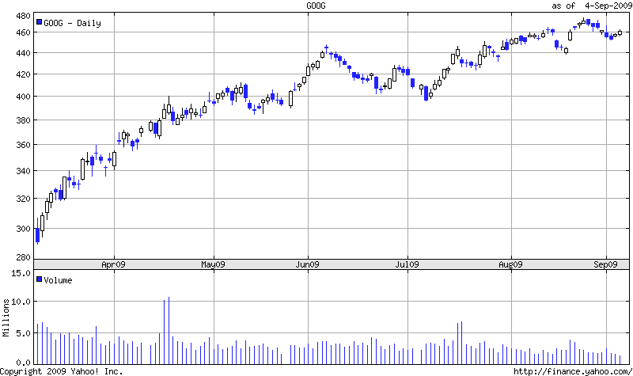
Example Applications
Trend lines, eg. Google 6 last 6 mo.
?

Slide 14


Others
Epidemiology
  Relating lifespan to obesity or smoking habits
  etc.
Science and engineering
  Relating phsyical inputs to physical outputs in complex systems
Grander
Input
Output

